Slide 1

United Nations Has Become Beholden to Feminist Ideology

Slide 2
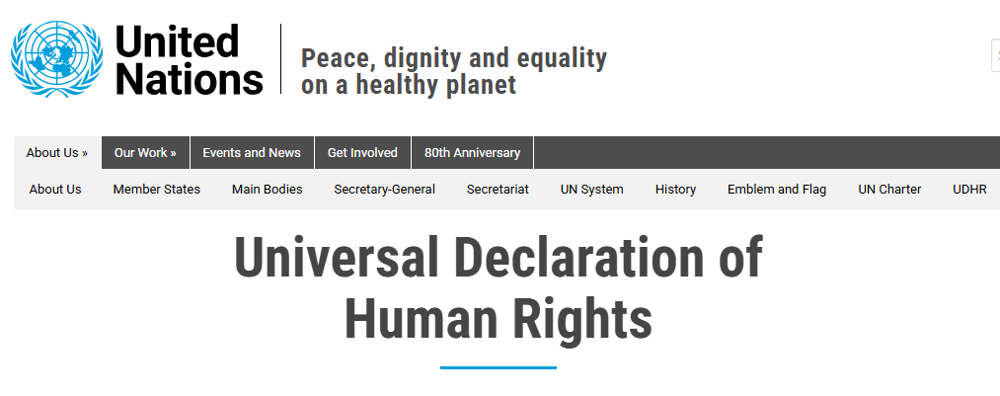
Universal Declaration of Human Rights
One of the founding documents of the United Nations.

Slide 3
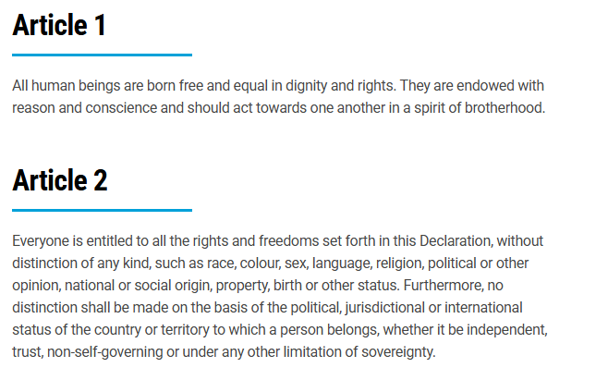
UDHR Explicitly Prohibits Sex Discrimination

Slide 4
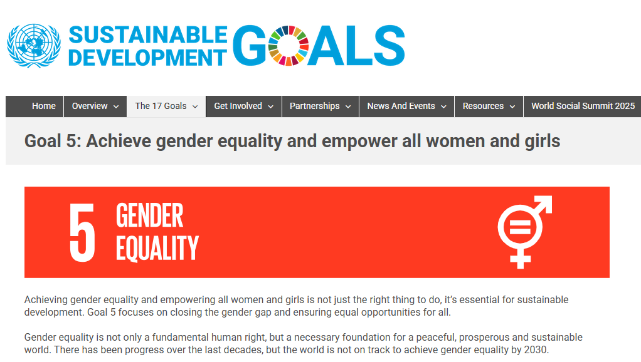
Sustainable Development Goals

Slide 5
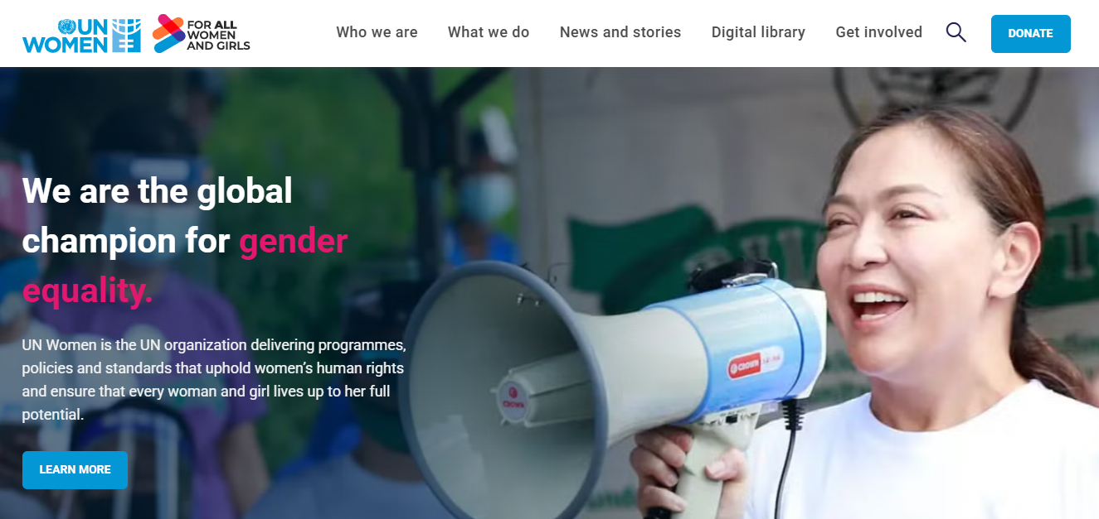
UN Women

Slide 6
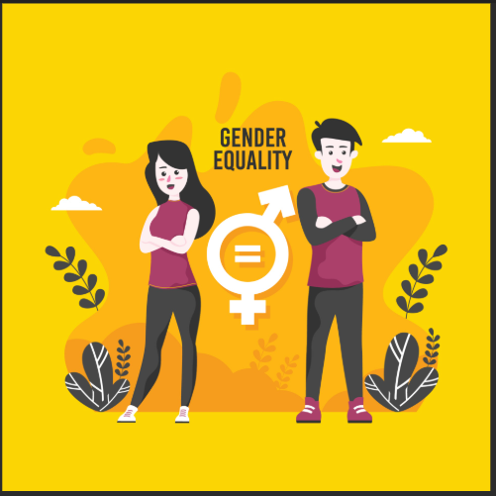
By Definition, “Gender Equality” Applies to Both Men and Women

Slide 7

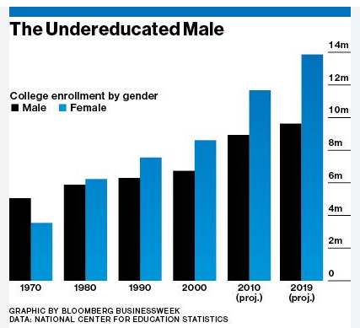
1. Education
The World Bank reports, “more than 100 countries have lower levels of male secondary and tertiary education enrollment and completion.”

Slide 8

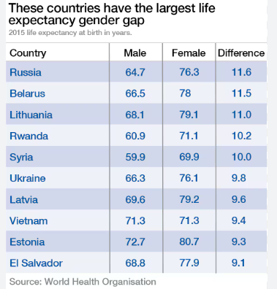
2. Health
The World Health Organization reports that around the world, men face a lifespan gender gap of 5 years.

Slide 9
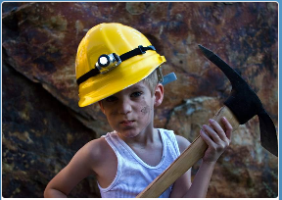
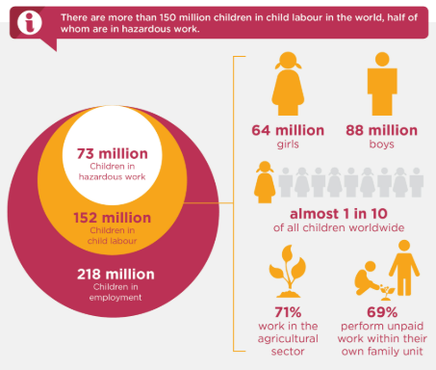
3. Boy Crisis
The International Labor Organization reports that among boys ages 5 to 17, 11.2% are in child labor, compared to 7.8% of girls.

Slide 10
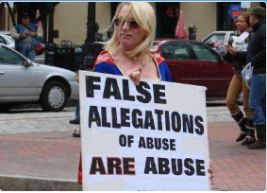
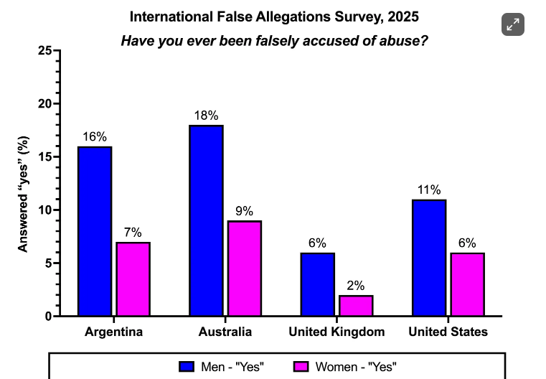
4. False Allegations
Men are twice as likely as women be victims of a false allegation of abuse.

Slide 11
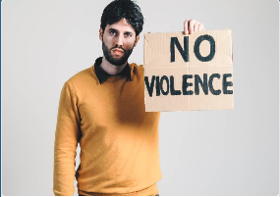
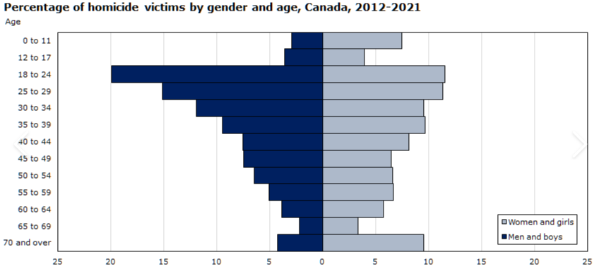
5. Victims of Violence
Males account for 78% of all homicide victims.

Slide 12
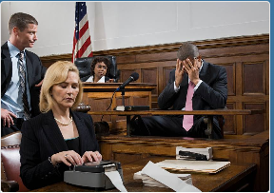
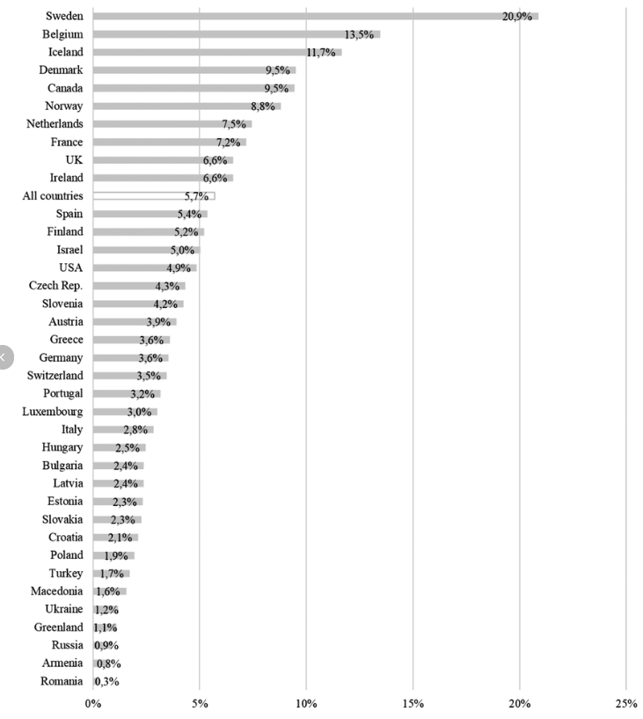
6. Shared Parenting
A survey conducted in 37 North American and European countries found that joint physical custody was awarded to fathers in fewer than 5% of cases.

Slide 13

7. Treatment by the
Legal System
Men encounter more severe treatment at every step of the criminal-legal process

Slide 14
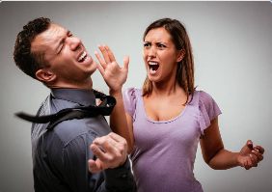
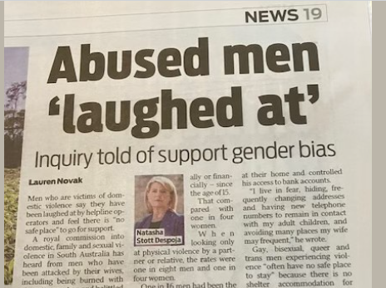
8. Domestic Violence
Far fewer services are available for male victims, even though men are equally likely to be victims of partner violence.

Slide 15
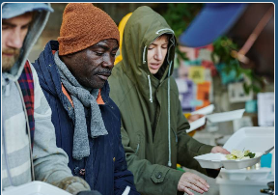
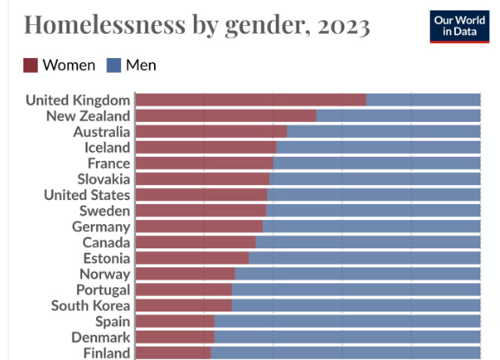
9. Homelessness
Globally, 76% of homeless persons are male.

Slide 16

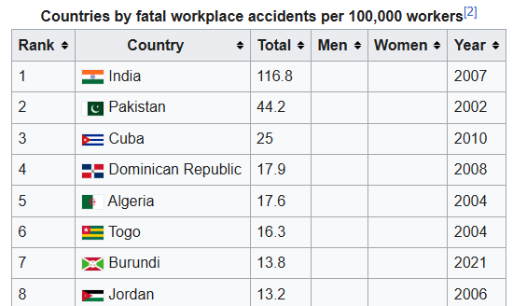
10. Occupational
Deaths
Men face 15 times the number of occupational deaths from accidents, compared to women:
Men: 6.2 deaths/100,000 workers, Women: 0.4/100,000 workers.

Slide 17
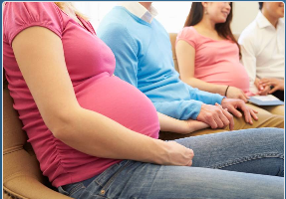
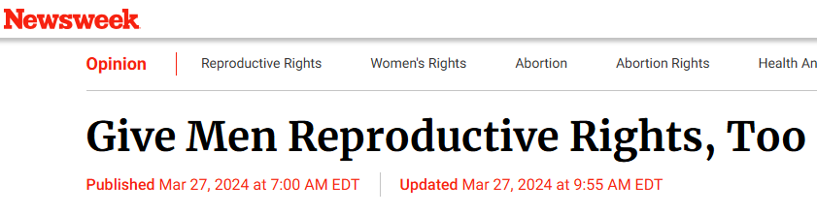
11. Reproductive and
Adoptive Rights
In most countries, men have fewer adoptive and reproductive rights.

Slide 18

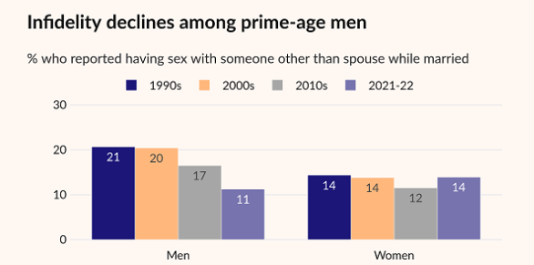
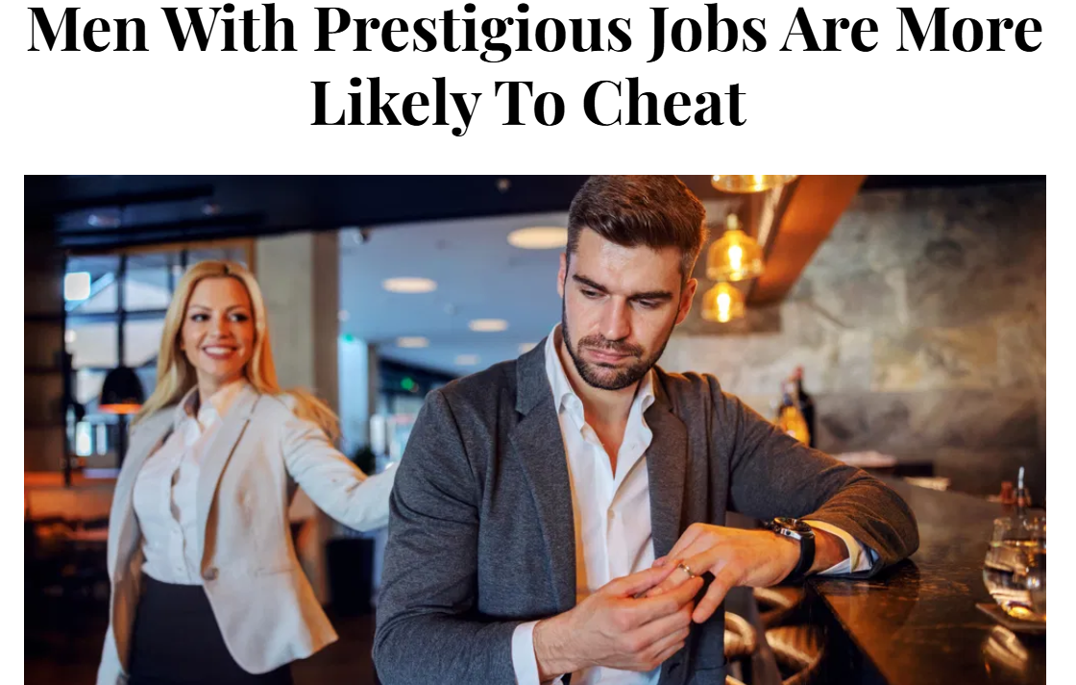
12. Media Portrayals
A multi-country analysis found that media portrayals of men are:
69% unfavorable, 12% favorable, and 19% neutral or balanced.
Example from the Institute for Family Studies:

Slide 19
So what is the United Nations doing to address the 12 areas of male inequality?
We conducted an in-depth search of UN programs designed specifically for men, at these UN agencies:
1. Human Rights Council
2. UN Population Fund
3. UNICEF – United Nations Children’s Fund
4. World Health Organization
5. International Labor Organization

Slide 20
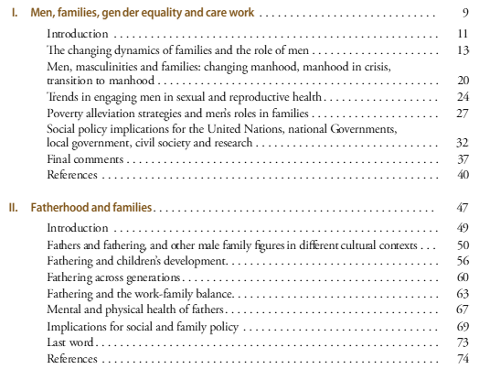
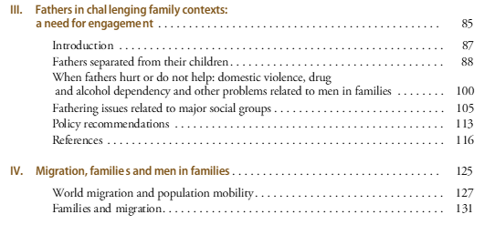
1. Department of Economic and Social Affairs, Fatherhood and Families, 2011

Slide 21
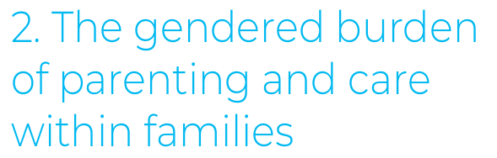

2. UNICEF: Family and Fatherhood: A Gender Transformative Approach, 2020

Slide 22
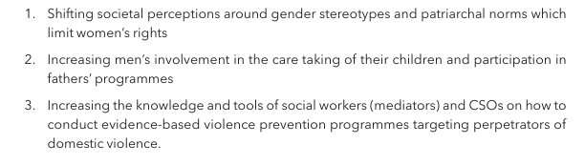
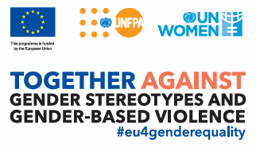
3. UNPF: Compendium on Fatherhood Programmes, 2021

Slide 23
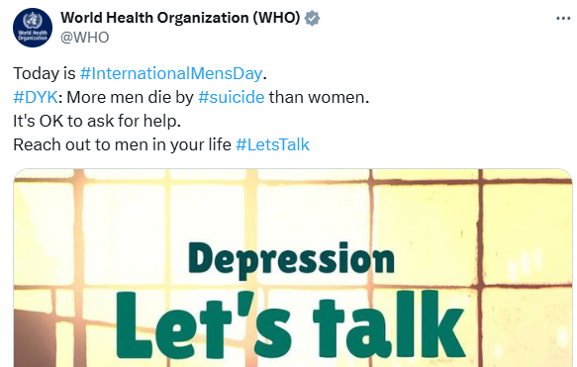
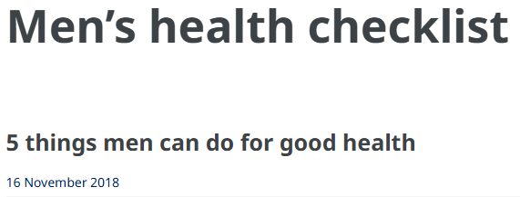
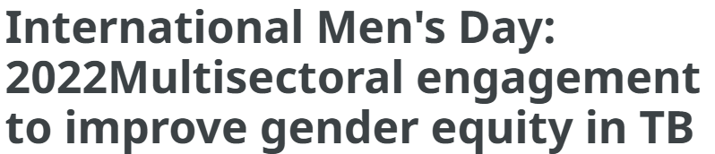
4. World Health Organization – International Men’s Day

Slide 24
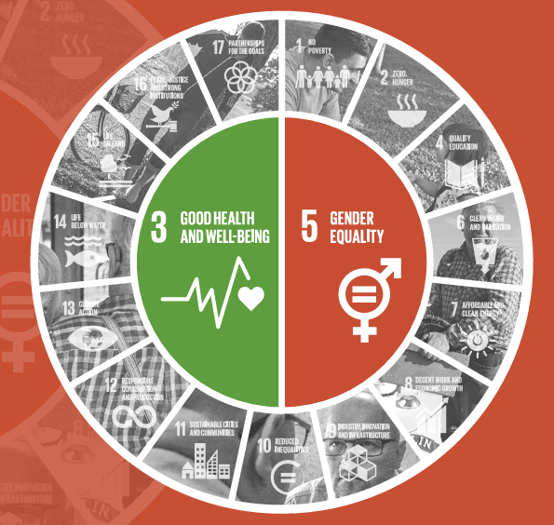
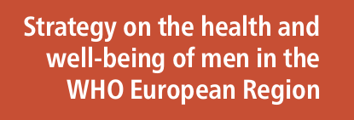
5. World Health Organization – European Region, 2018

Slide 25
How Well Has the UN Addressed the Challenge of Gender Equality?
1. Men’s Health: The WHO has addressed men’s health on several occasions, but still places far greater attention on women’s health.
2. Shared Parenting: Three publications addressed increased fatherhood involvement in the care of their children, but none of them make any mention of equal custody arrangements.
3. The other 10 areas of male disparity are flatly ignored.

Slide 26
Conclusion: Far less than 1% of the UN gender equality budget addresses the 12 areas of male disparity.
Over 99% of the gender equality budget is allocated to “gender equality for women.”
This represents a repudiation of the Universal Declaration of Human Rights, a rejection of science, and an embarrassment to common sense.
So what the heck is going on?

Slide 27
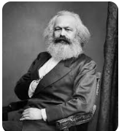
1. Marxist Interpretations
UN Secretary-General Antonio Guterres is a lifelong socialist. He served as President of the Socialist International from 1999 to 2005.
In Marxist societies, “equality” refers to uniform outcomes. In contrast, in democratic societies, “equality” refers to equal rights and opportunities.
The United Nations has adopted a Marxist interpretation of “equality.”

Slide 28
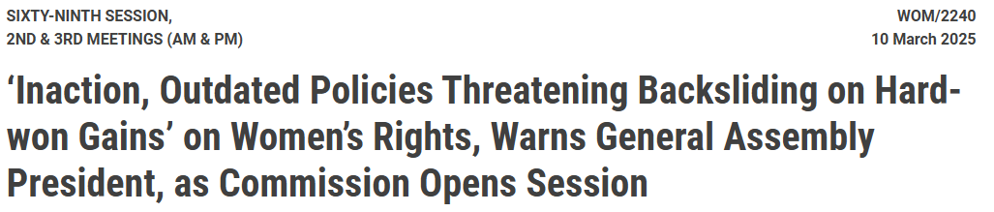
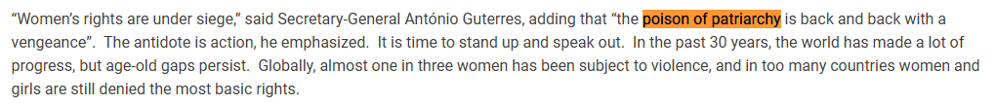
Perceptions of ‘Patriarchy’ are Widespread in the UN System

Slide 29

2. Lack of Accountability for
UN Women
1. The total budget of UN Women in 2023 was $567 million.
2. Of that amount, the “assessed contributions” allocated from the General Assembly were only $10.1 million. This amount is less than 2% of the total budget of UN Women. https://www.unwomen.org/en/executive-board/strategic-plan/resources
3. As a result, UN Women is largely unaccountable to the General Assembly.

Slide 30
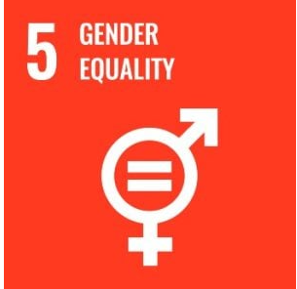
3. Sustainable Development
Goals for Gender Equality
The SDGs are written as aspirational goals, which are by definition unattainable:
“5.1 End all forms of discrimination against all women and girls everywhere.”
Interpreted in the Marxist sense: “5.5 Ensure women’s full and effective participation and equal opportunities for leadership at all levels of decision-making in political, economic and public life” – interpreted as women should represent 50% of all lawmakers.
Vague language: “5.5 Ensure women’s full and effective participation and equal opportunities for leadership at all levels of decision-making in political, economic and public life.”

Slide 31
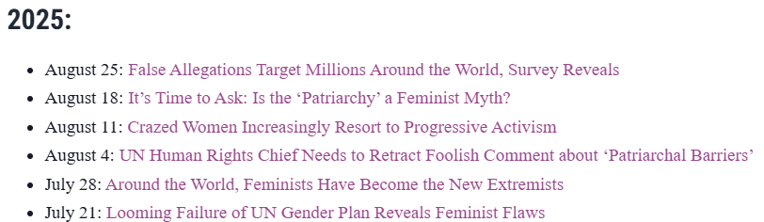
Corrective Strategies Taken Thus Far
1. Meetings with UN missions in New York City to explain 12 areas of male disparity. Response has been generally positive.
2. Encouraging organizations to contact UN ambassadors.
3. Press releases that expose the UN’s failure to address gender equality for men:

